Slide 1
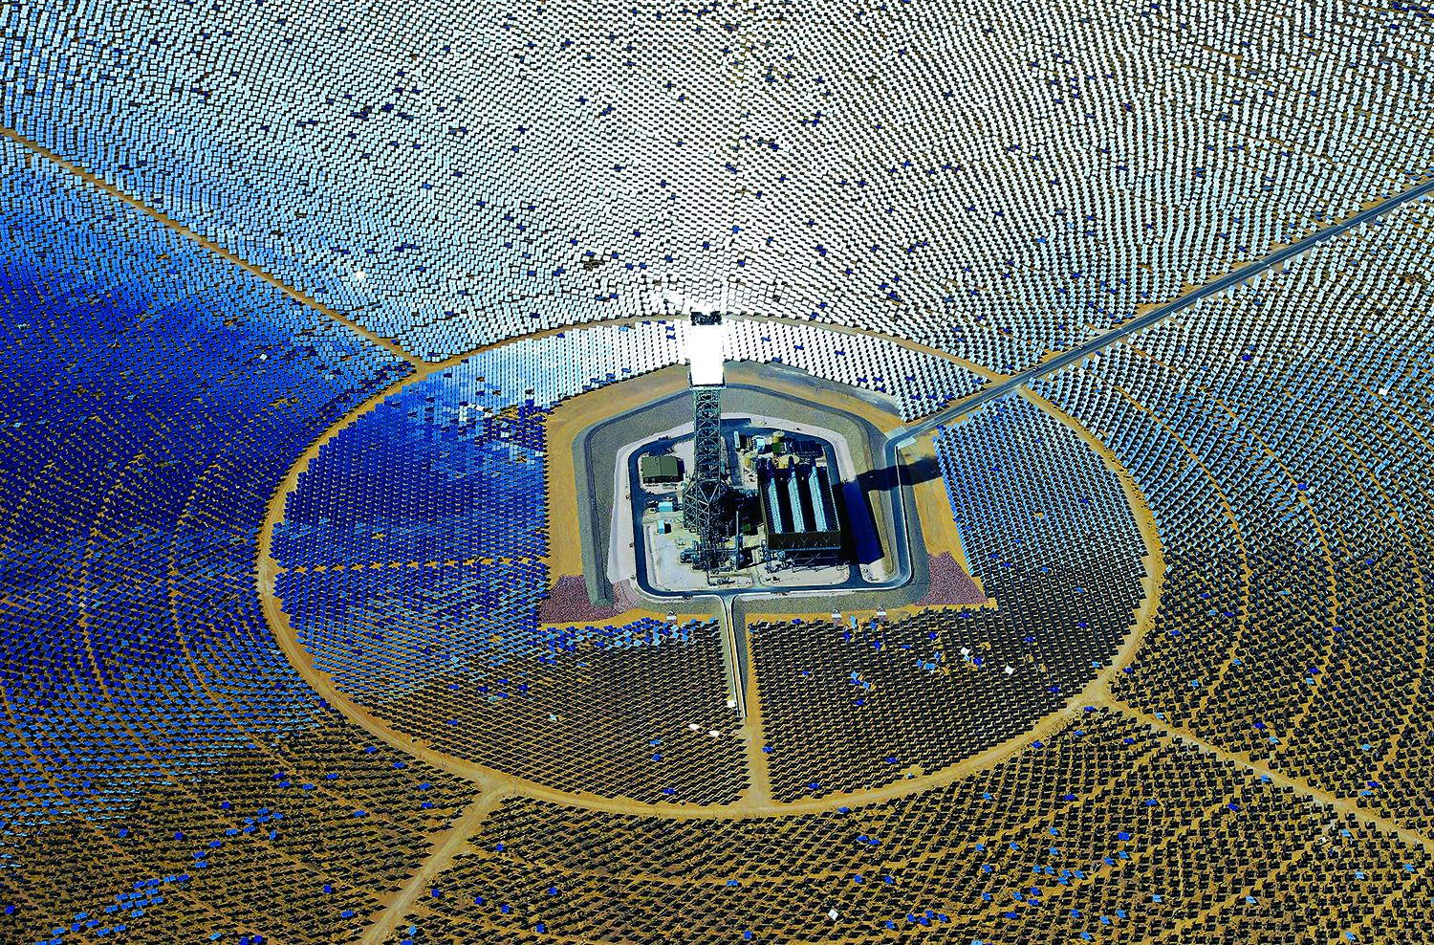
Investigating Solar Power
Ahmad, Sean E. & Sean T.

Slide 2
How Much Damage are Trump’s Solar Tariffs Doing to the U.S. Industry?
Billions in U.S. solar projects shelved after Trump panel tariff?
Trump hits solar imports with tariff but still concedes millions of jobs to China

Slide 3
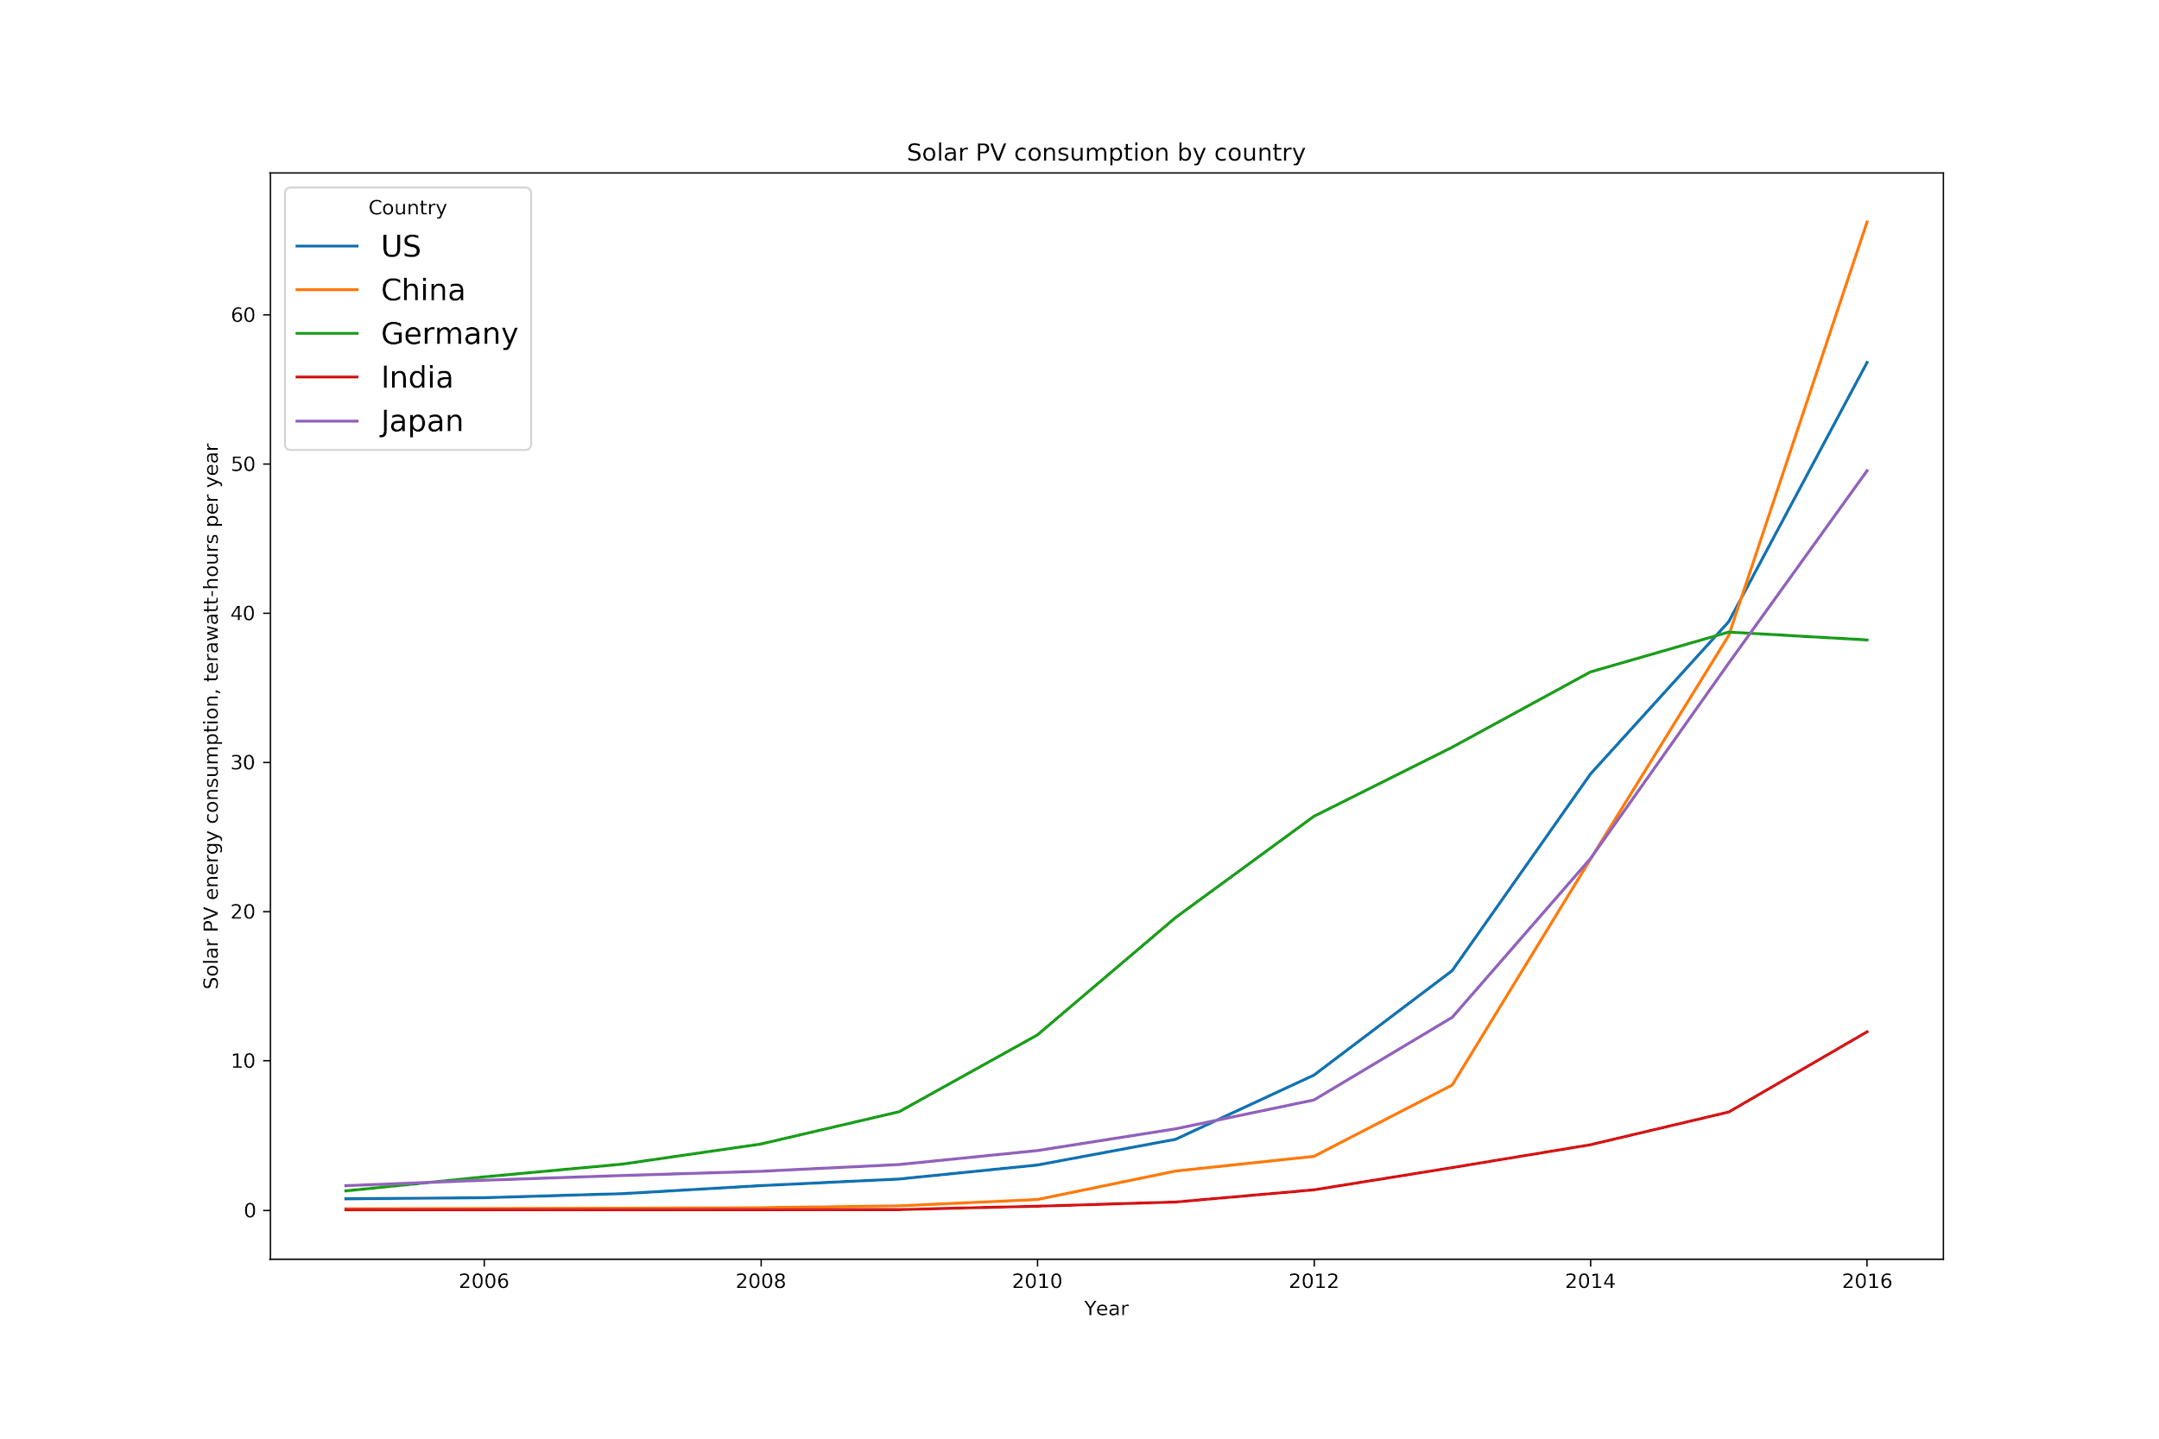

Slide 4
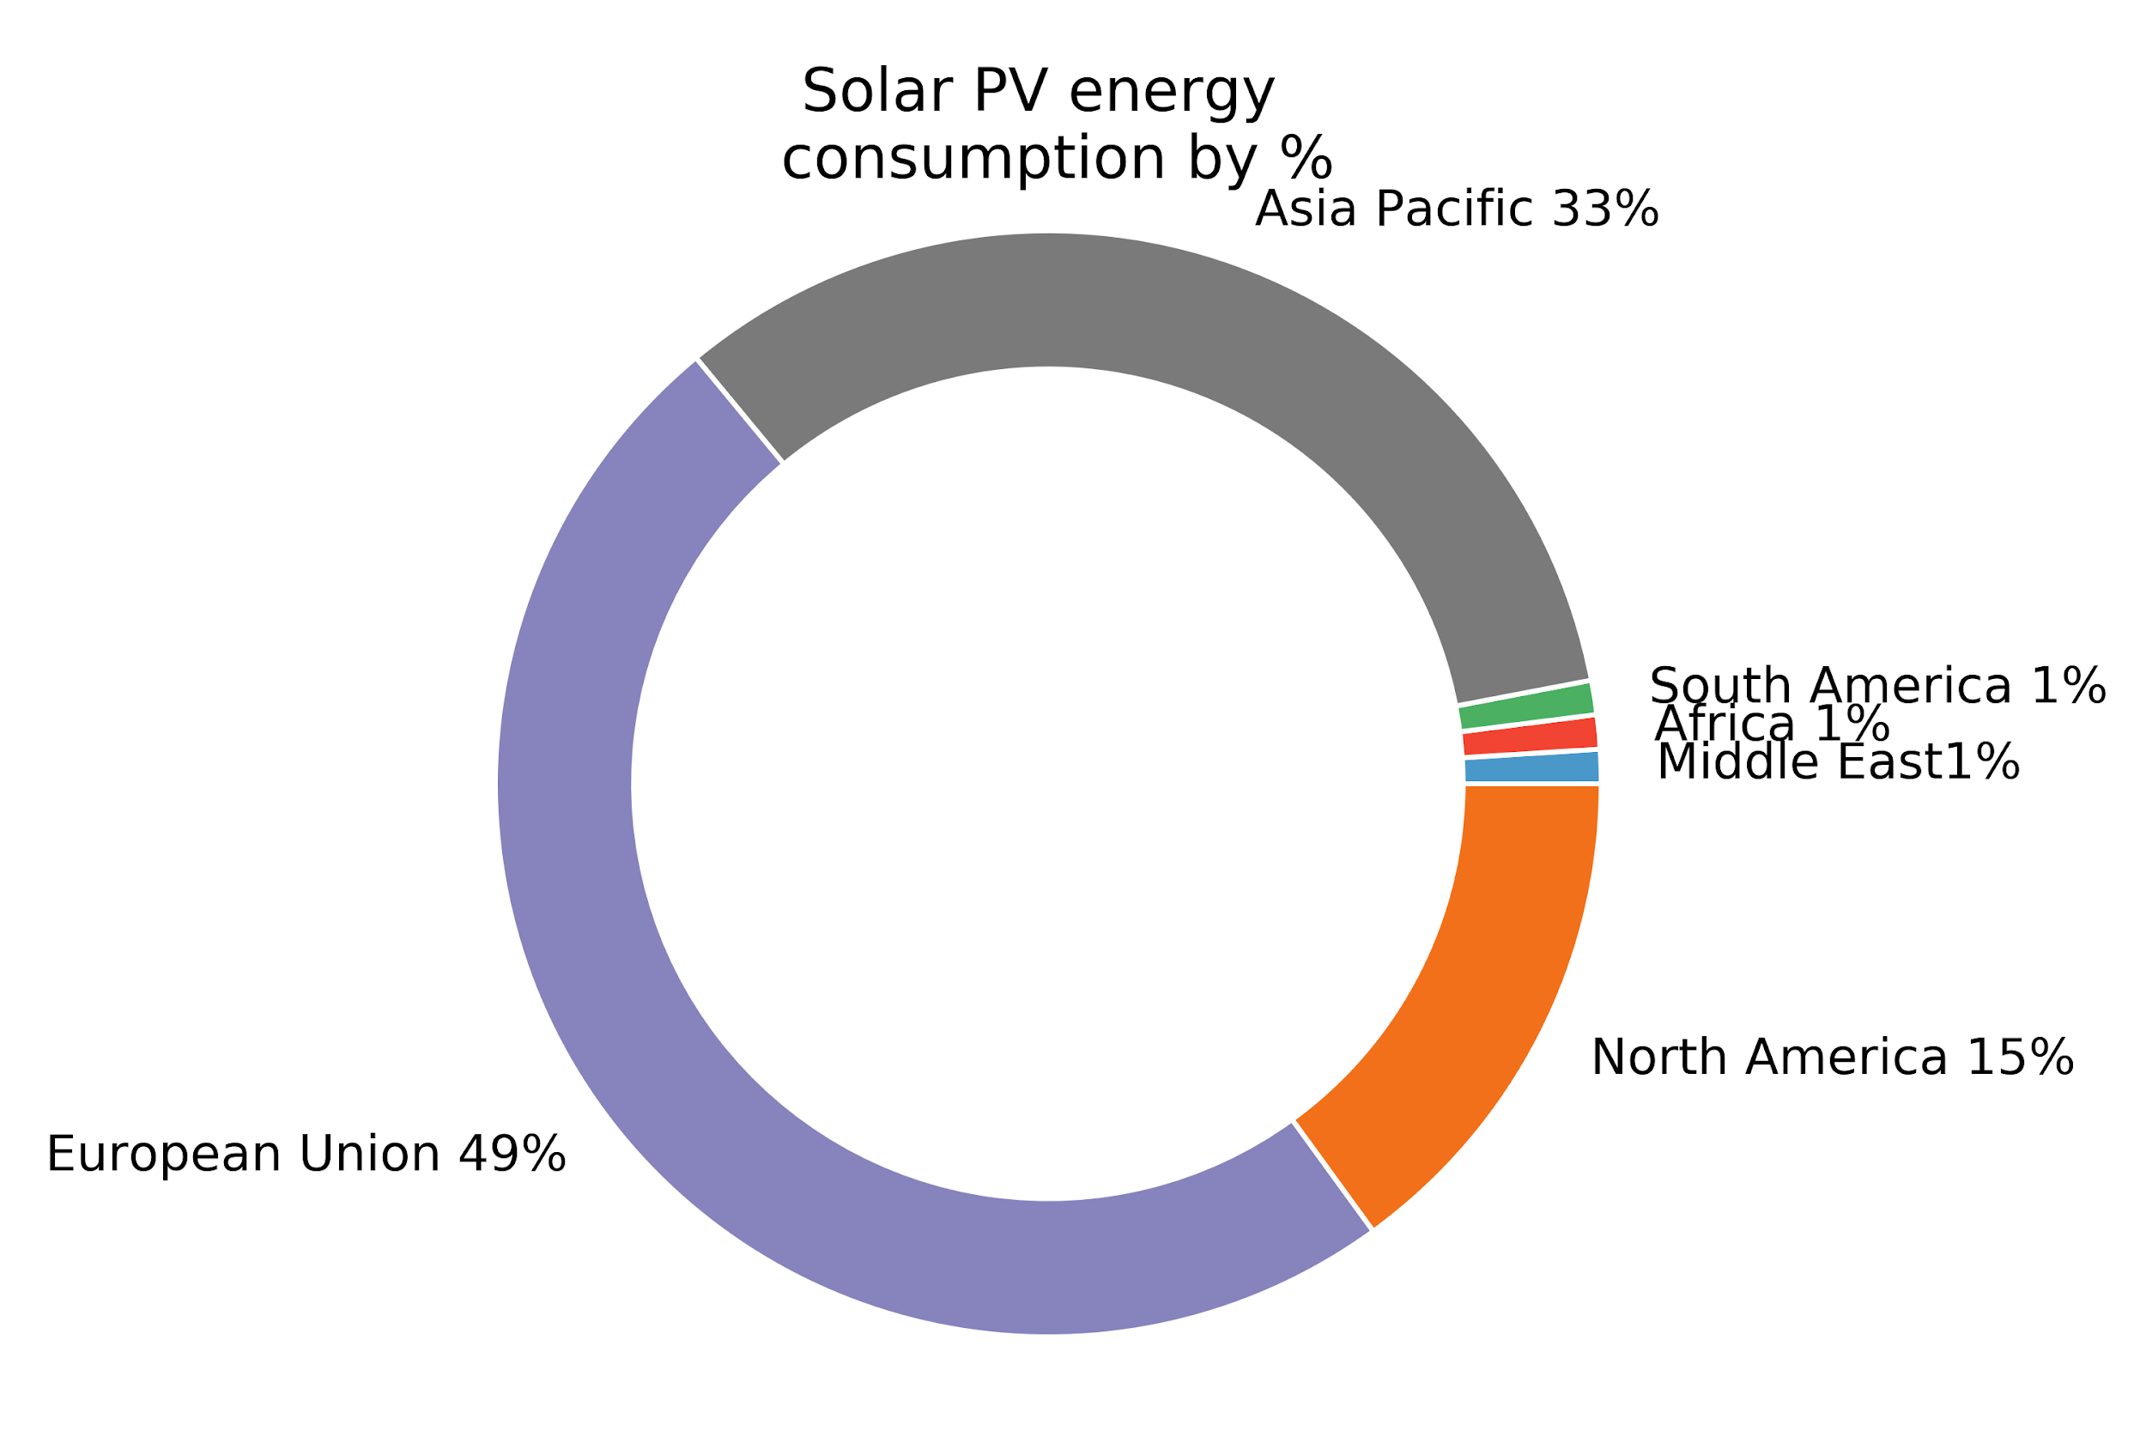

Slide 5
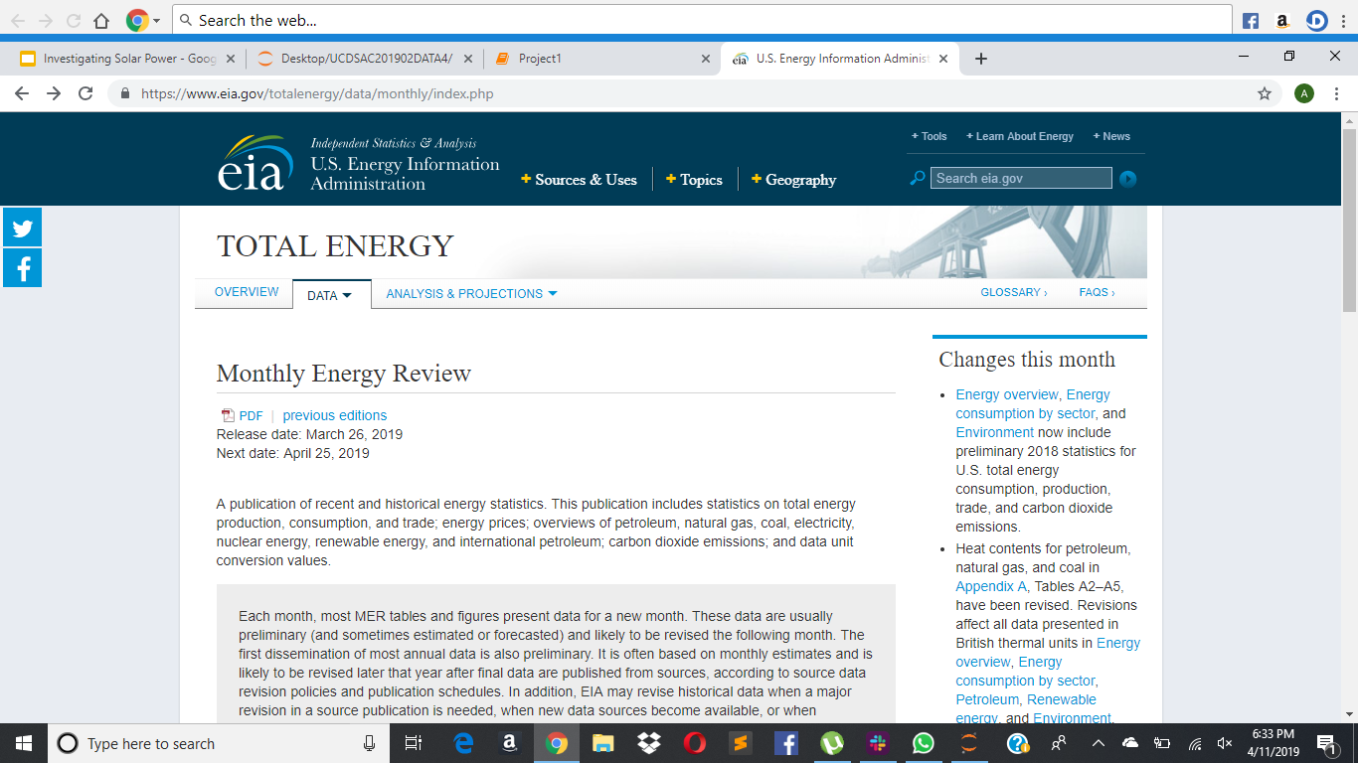

Slide 6
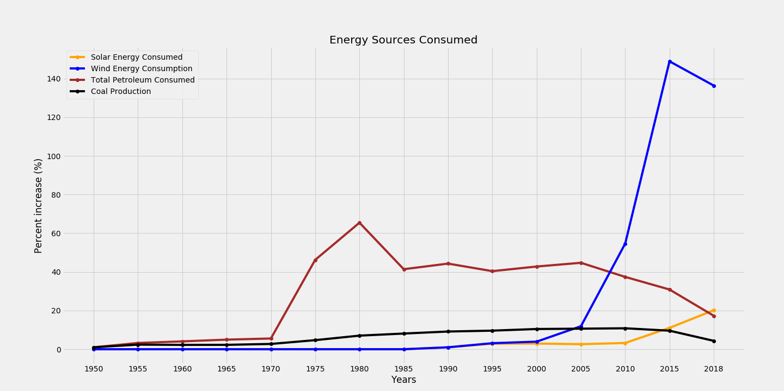
Energy Sources Consumed

Slide 7
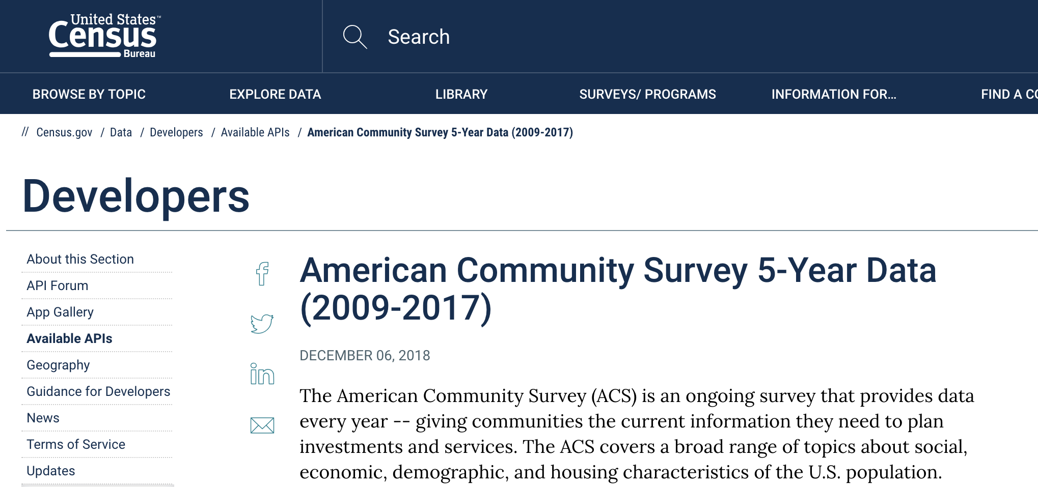
U.S. Census API: American Community Survey

Slide 8
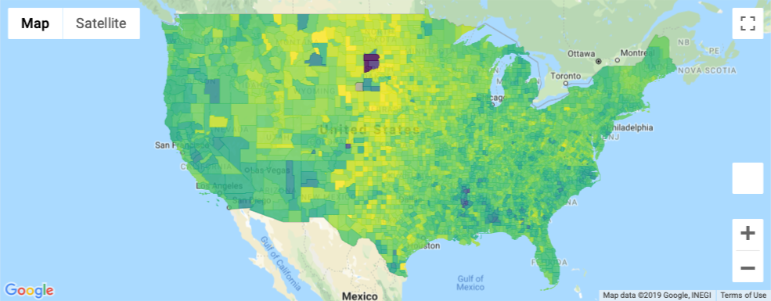
Unemployment Rate by County

Slide 9
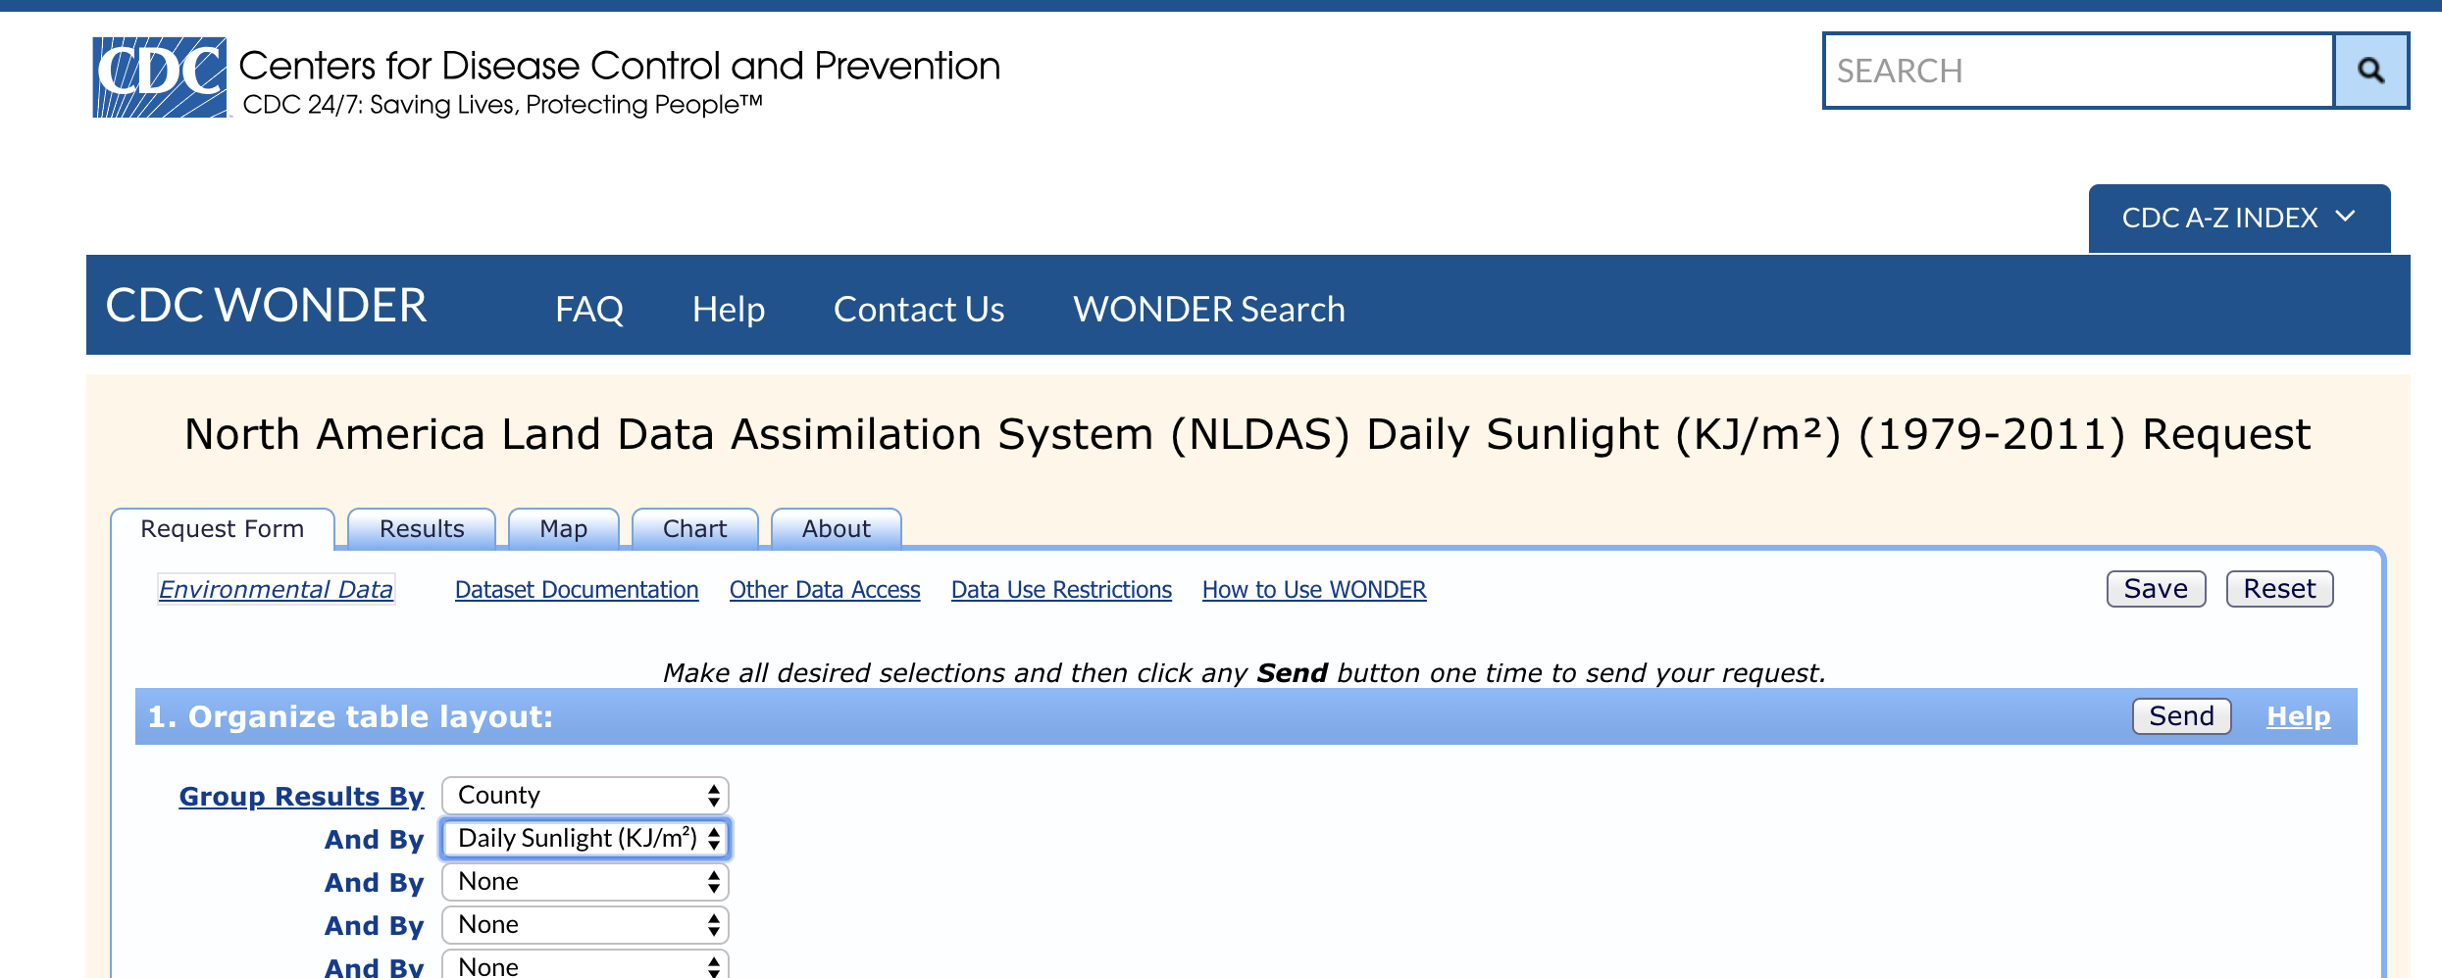
CDC NLDAS Insolation Data

Slide 10
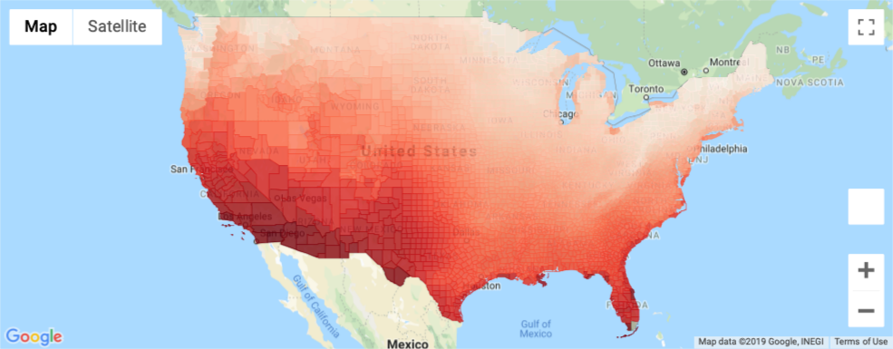
Sunniness by County
Darker red = Sunnier

Slide 11
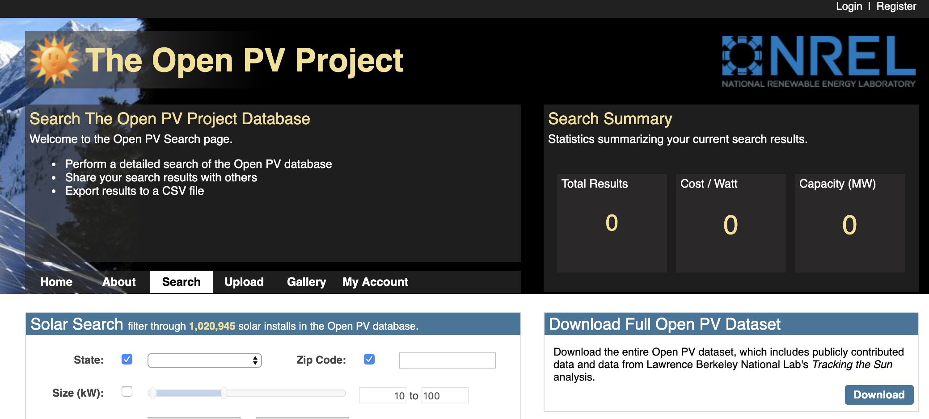
The Open PV Project

Slide 12
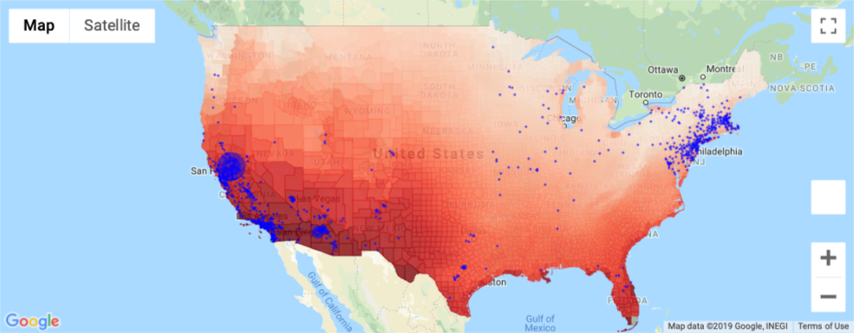
Sunniness vs. Solar Panel Installs
Blue dots = location and size of clustered solar panel installs

Slide 13
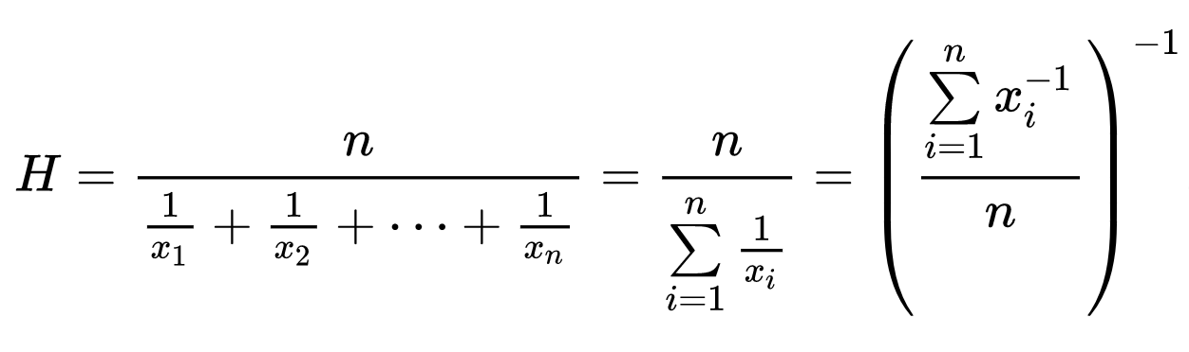
Combine Unemployment & Sunniness Rates
Used harmonic mean:
Better than arithmetic mean for combining rates over different denominators
(https://towardsdatascience.com/on-average-youre-using-the-wrong-average-geometric-harmonic-means-in-data-analysis-2a703e21ea0)

Slide 14
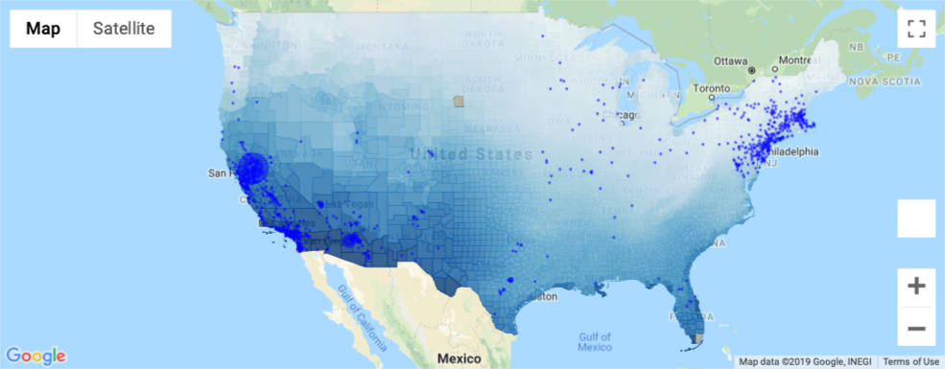
Sunniness & Unemployment vs. Installs
Darker blue counties = higher unemployment + higher sunniness. Bright blue = locations and size of clustered solar installs.

Slide 15
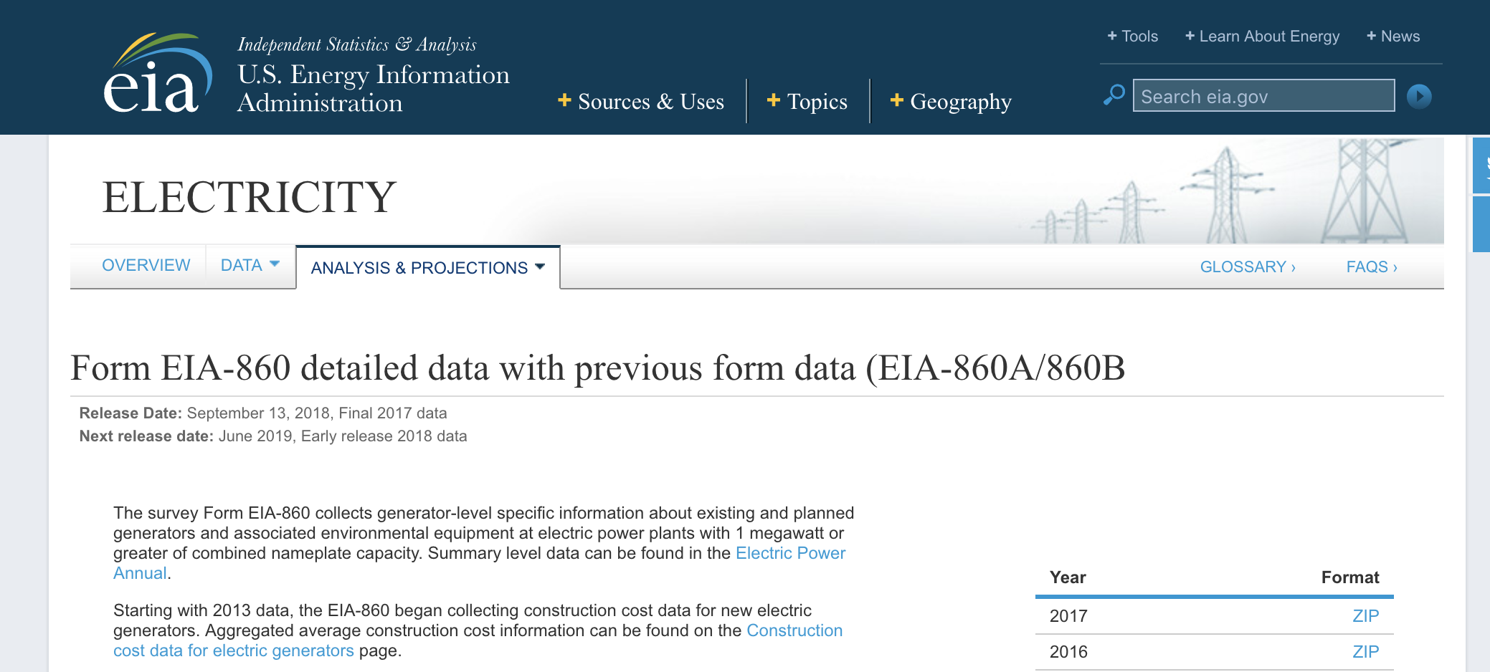
U.S. Energy Information Administration (EIA) Data

Slide 16
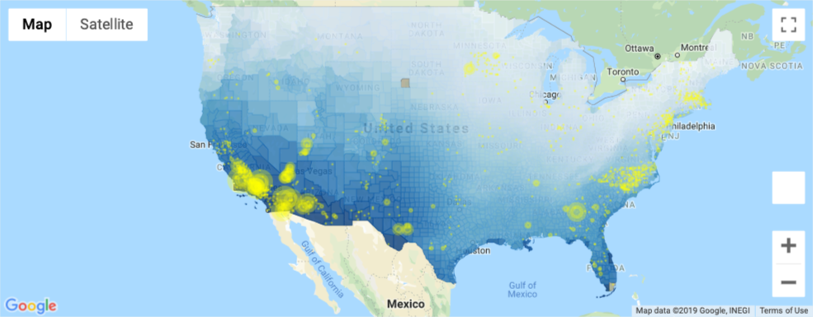
Sunniness & Unemployment vs. Solar Utilities
Darker blue = higher unemployment + higher sunniness. Yellow = locations and size of clustered solar utilities.

Slide 17
